Slide 1
Plots Control

Slide 2
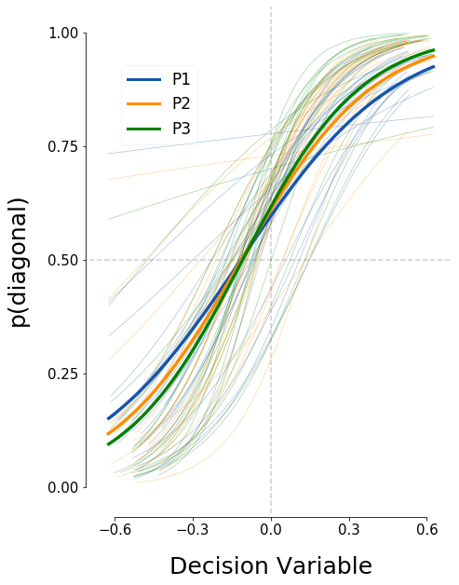
Control. Logistic regression fit for each presentation

Slide 3
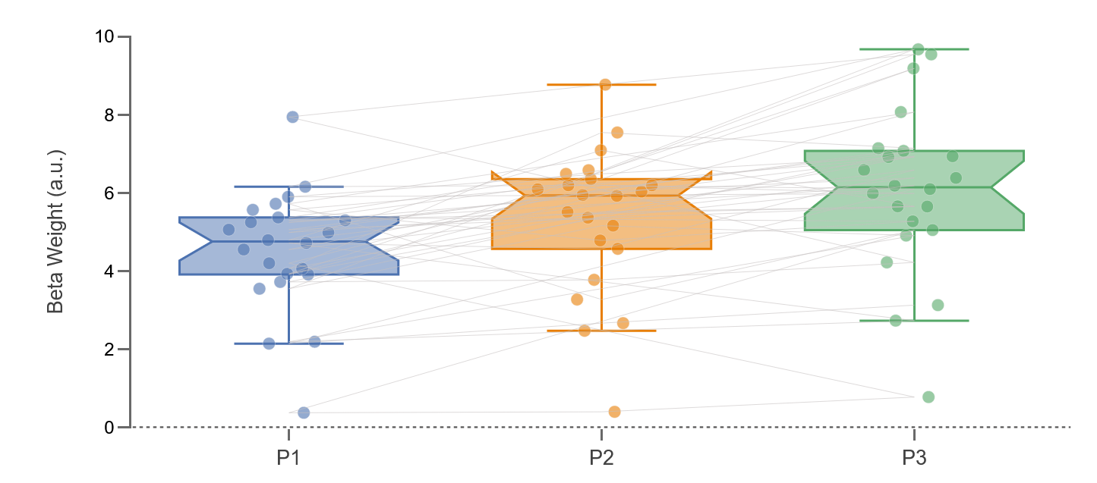
Control. Beta weight for each presentation.

Slide 4
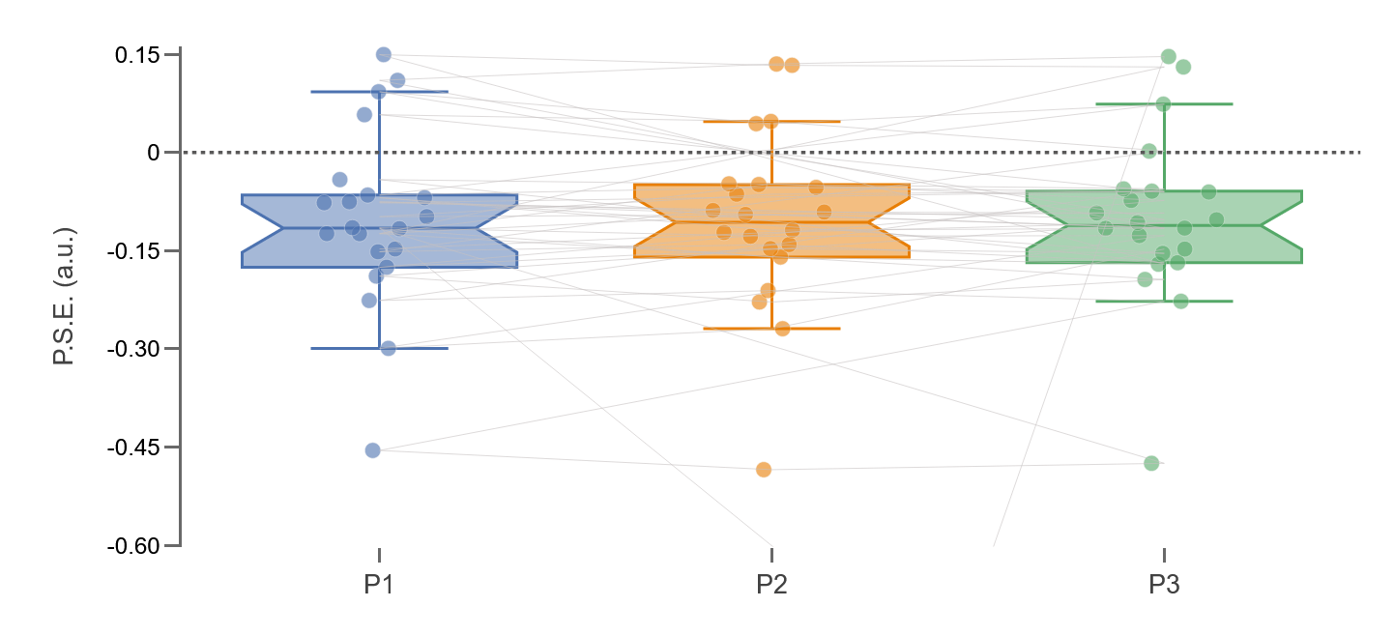
Control. PSE for each presentation.

Slide 5
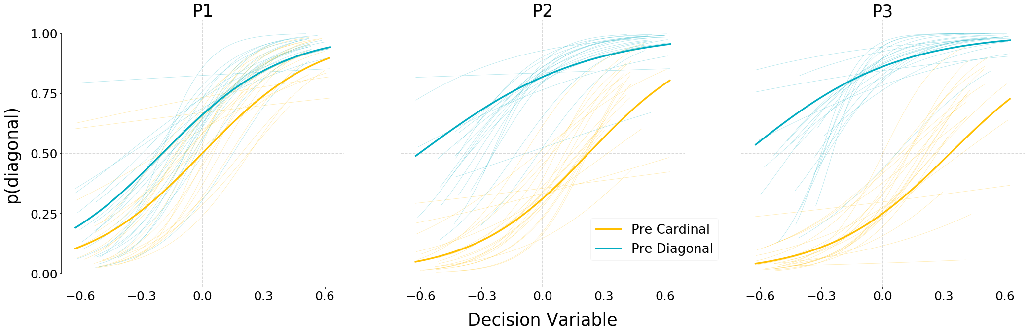
Control. Logistic regression fits for each presentation separated by cardinal & diagonal.

Slide 6
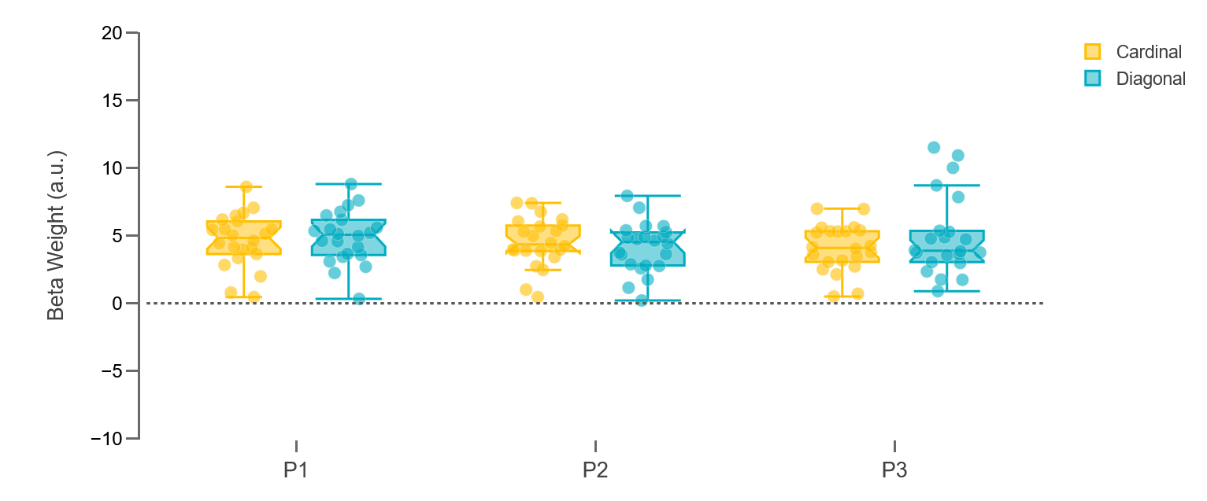
Control. Beta weight by presentation and condition

Slide 7
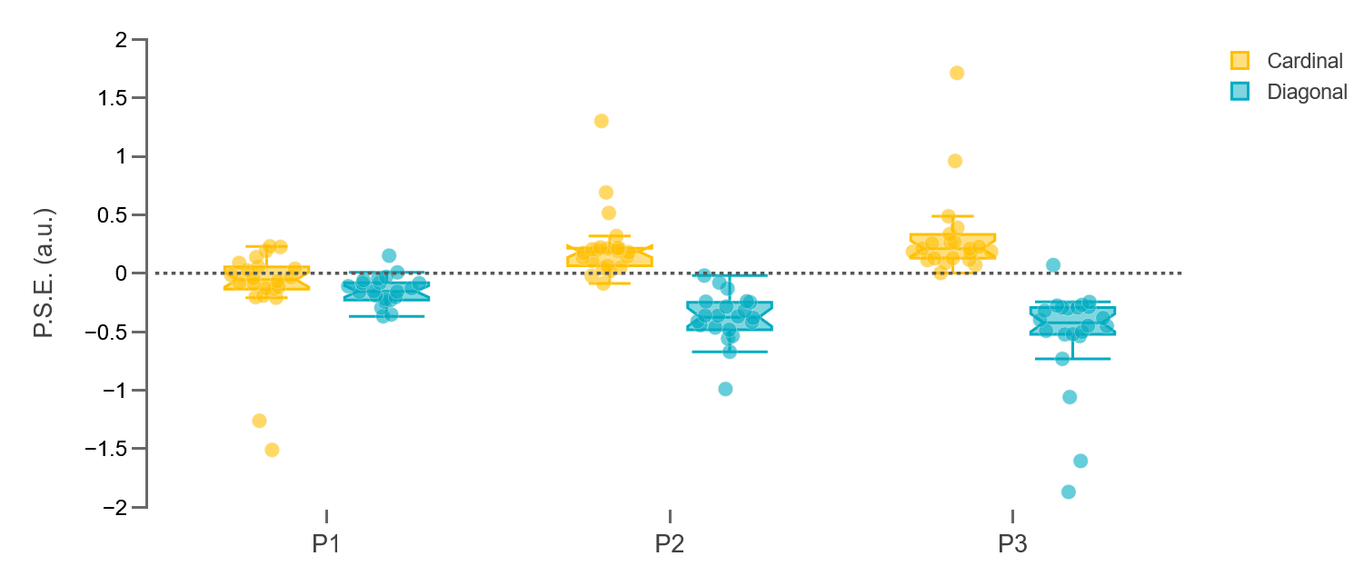
Control. PSE by presentation and condition.

Slide 8
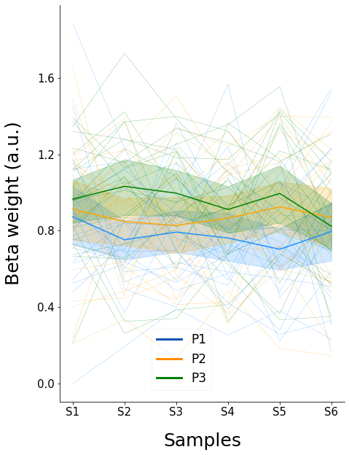
Control. Beta Weight by presentation and sample.

Slide 9
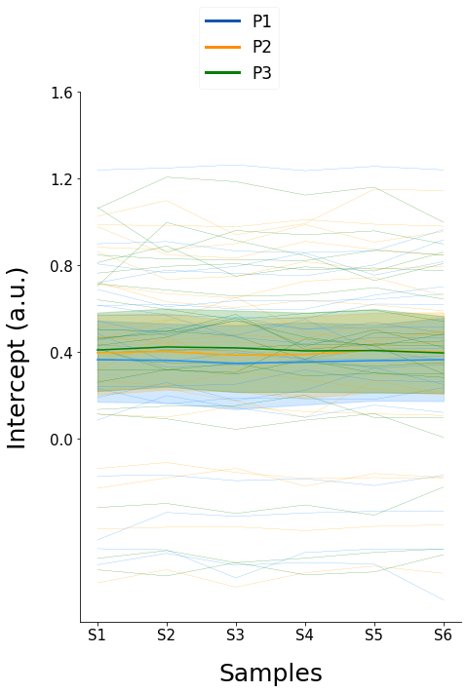
Control. Intercept by presentation and sample.

Slide 10
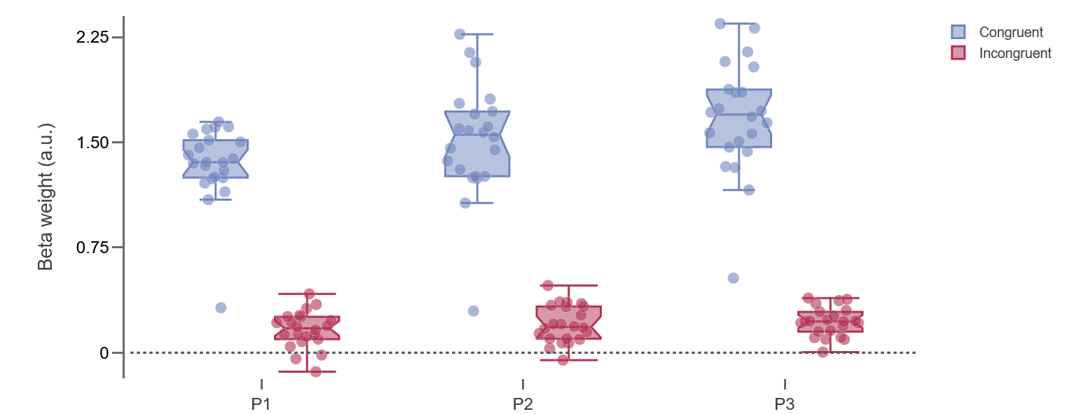
Control. Category similarity between consecutive samples. Weight

Slide 11
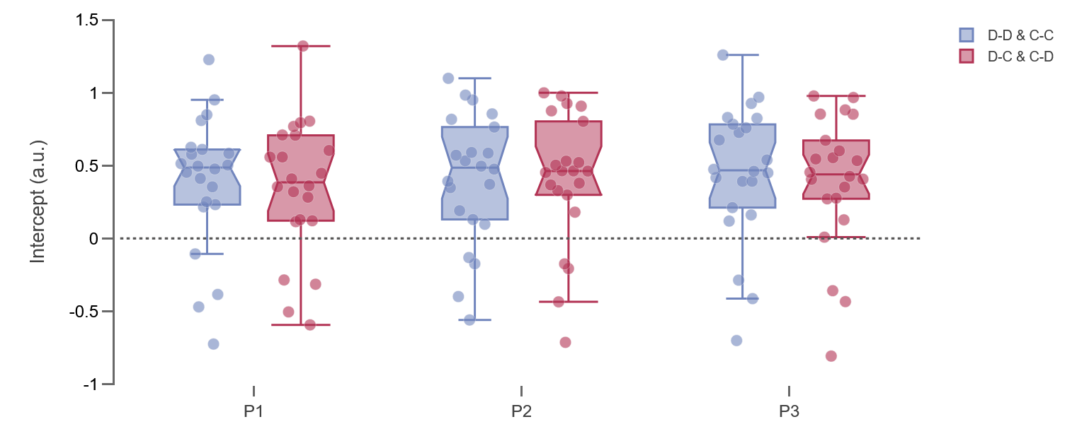
Control. Category similarity between consecutive samples. Intercept

Slide 12
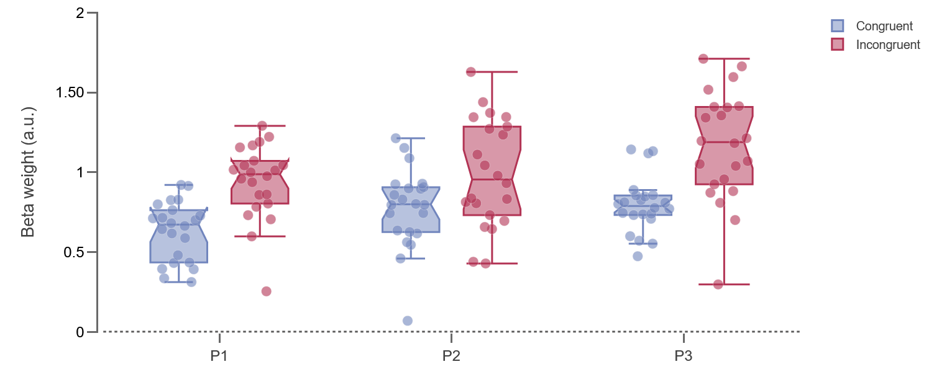
Control. Physical similarity between consecutive samples. Weight

Slide 13
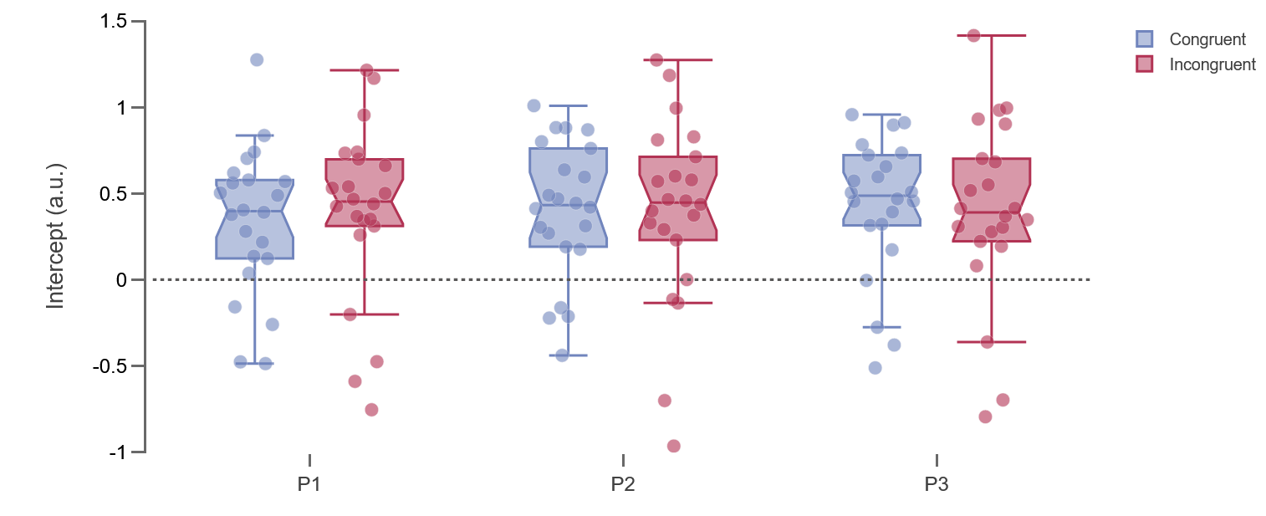
Control. Physical similarity between consecutive samples. Intercept

Slide 14
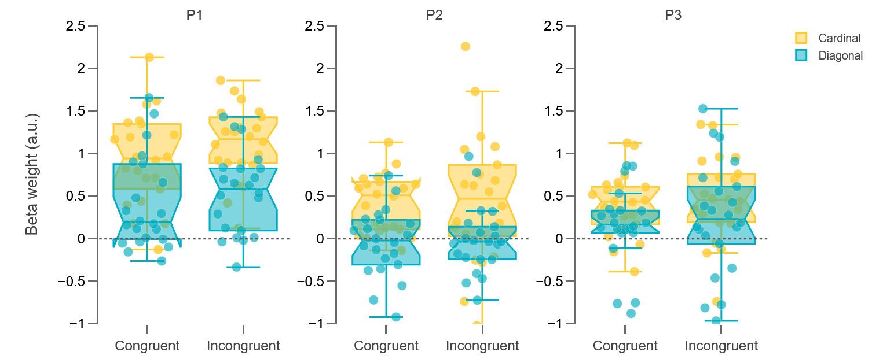
Control. Beta Weight for physical similarity between stimuli samples and previous decisions.

Slide 15
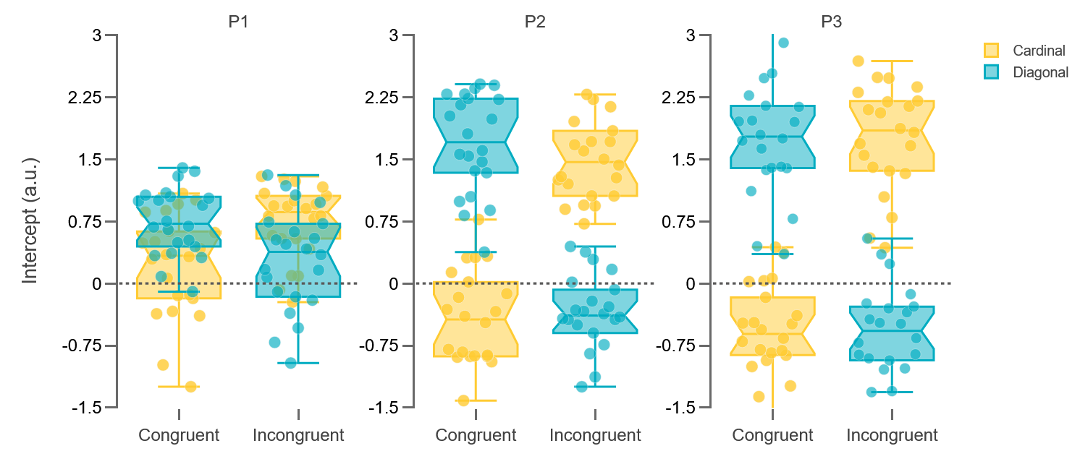
Control. Intercept for Physical similarity between stimuli samples and previous decisions.

Slide 16
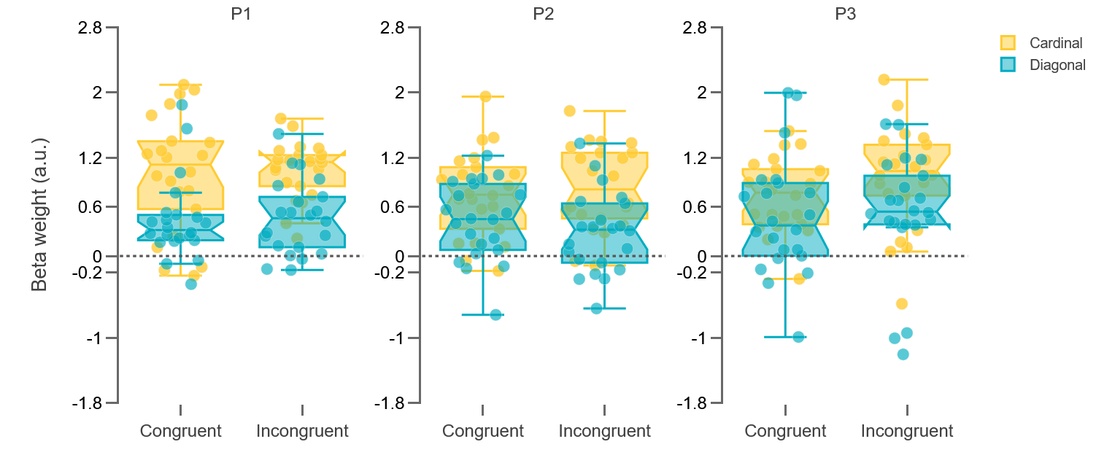
Control. Beta Weight for Categorical similarity between stimuli samples and previous decisions.

Slide 17
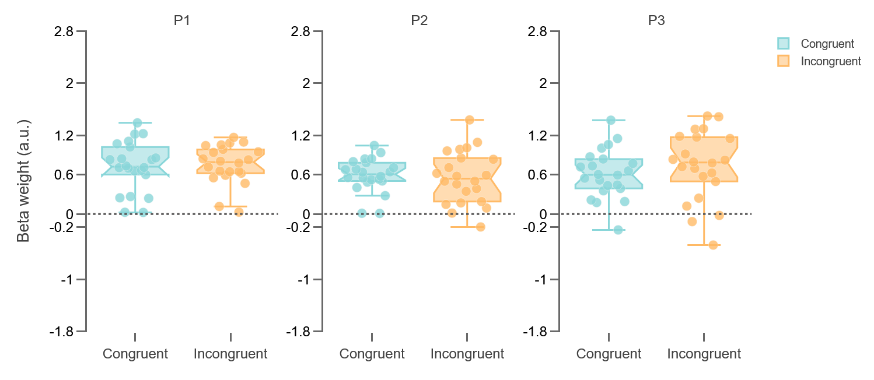
Control. Beta Weight for Categorical similarity between and previous decisions.

Slide 18
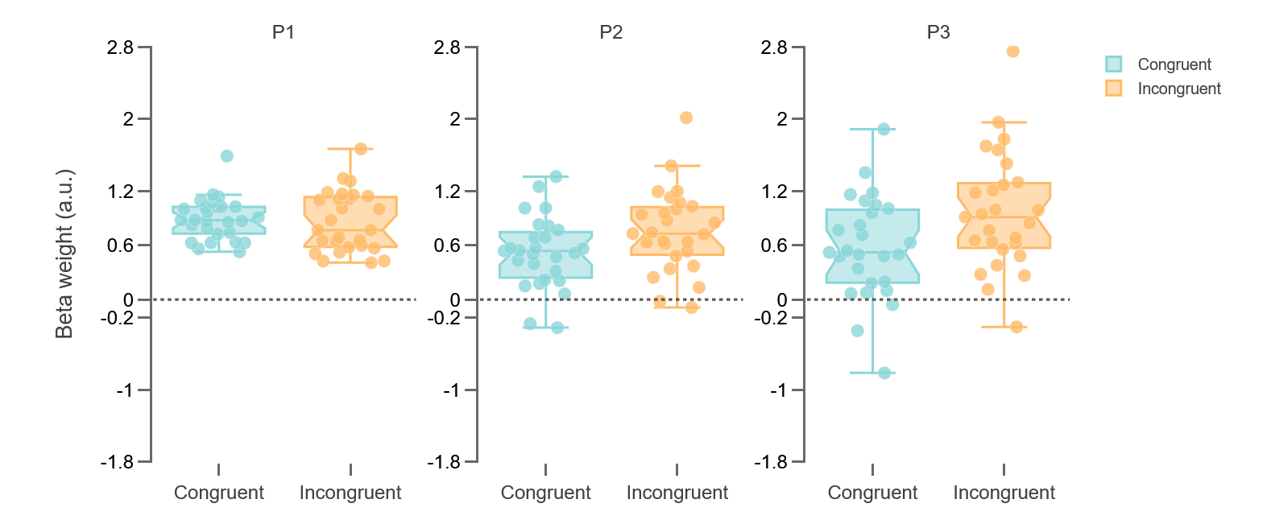
Experiment. Beta Weight for Categorical similarity between and previous decisions.

Slide 19
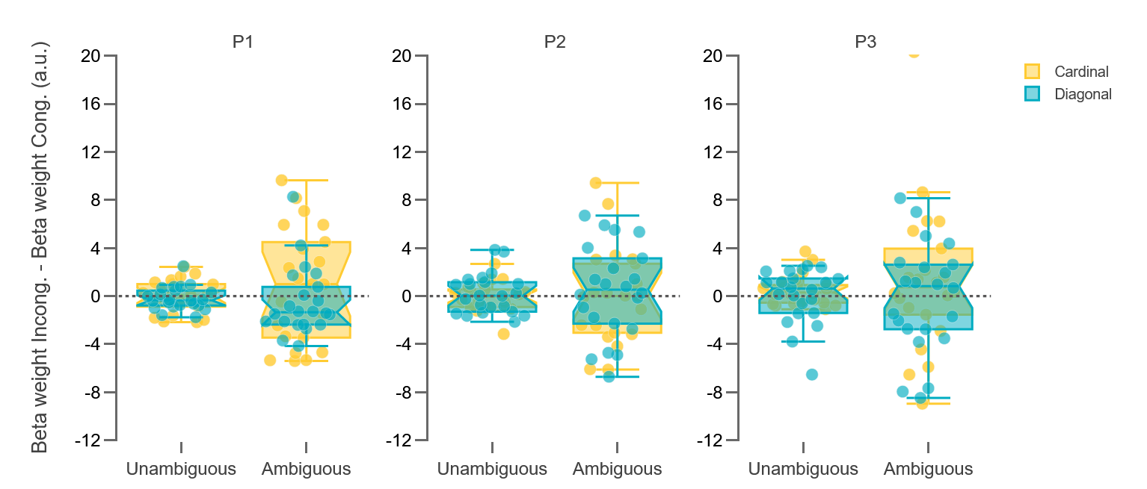
Control. β Weight by Incongruent Samples minus β Weight by Congruent Samples divided by Ambiguous and Unambiguous samples and by Conditions..

